Slide 1
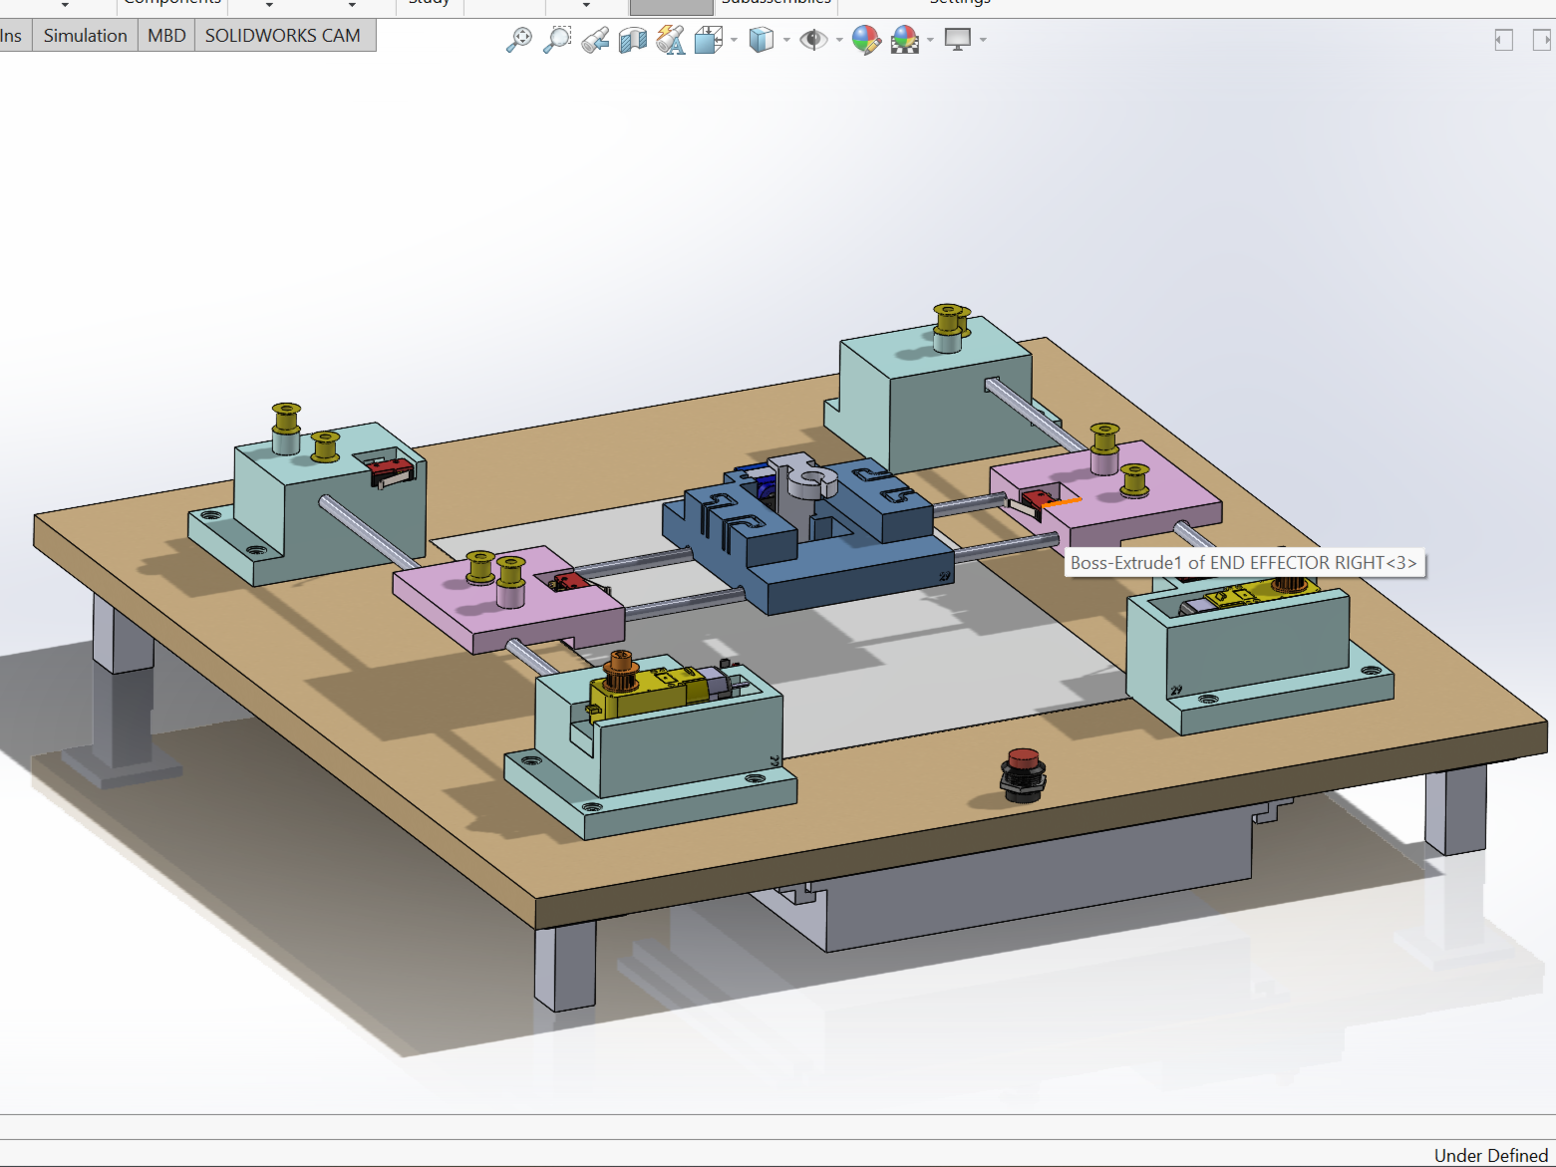

WORKSHOP MECHATRONICS XY PEN-PLOTTER
Team: (2nd cohort)-29
Choudhary, Prithviraj : 315448
Gangiredla, Varun Kumar : 315461
Khule, Nitin : 315513
Pandaraboyana, Dheeraj Kumar : 315535
Rao, Parul Vivek Sunder : 315476

Slide 2
Table of contents
1. INTRODUCTION
2. PROJECT GOALS & PROJECT PLANNING
2.1 Project Goals and Objectives
2.2 Organisation Chart
2.3 Project Timeline
2.4 Project V-model
2.5 Morphological Chart
3. DESIGN STAGE
3.1 Component Selection
3.2 Electrical Design
3.3 Mechanical CAD Design
3.4 Programming
4. DEVELOPMENT AND FABRICATION STAGE
4.1 Selection of materials
4.2 Application of test piece
4.3 Challenges faced during Development Stage:
5. TESTING AND ITERATION
5.1 Testing Procedure
5.2 Performance testing & Calibration
6. CONCLUSION
6.1 Task: Plot Nikolaus House
6.2 Future Scope

Slide 3
INTRODUCTION

Slide 4
Introduction
Hello and welcome to our presentation on the pen plotter, a cool device made by us as part of our mechatronics project. We're excited to share the journey of creating this innovative gadget, from the idea to the final product.
A pen plotter is a computer-controlled device that uses pens to make Nikolaus house on paper. Our project focuses on building a working pen plotter using specific components and technologies, showcasing the integration of hardware, software, and mechanical parts to get a job done.
In this presentation, we'll walk you through the main stages of our product development: design, development, and fabrication. We'll talk about the challenges we faced, the goals we aimed for, and how we used our creativity and technical skills to design a strong and efficient pen plotter.

Slide 5
PROJECT GOALS & PROJECT PLANNING

Slide 6
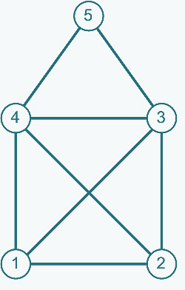
Project Goals and Objectives
The primary objective of our project is to create a pen plotter by assembling all the required components. These components will ensure the correct movement of the pen and accurate drawing on paper. We, as the project team, will design and assemble the necessary pieces, program the control system, and construct the pen plotter.
What is our aim?
To design and program a xy pen plotter that can draw in a 2D plane
The plotting area should be 100mm*100mm
It should have movements in x and y direction
It should be able to draw Nikolaus' house

Slide 7
Organisation Chart
Prof. Dr. Stefan Roth
Prof. Dr.-Ing. Silvio Bachmann
Choudhary, Prithviraj
CAD Design & Mechanical Assembly
Pandaraboyana, Dheeraj Kumar
Electrical Design & Electrical Wiring
Functional Coding
Khule, Nitin
Project Documentation
CAD Design
Mechanical Assembly
Rao, Parul Vivek Sunder
User Requirements
Design Specifications
Gangiredla, Varun Kumar
Electrical Wiring
Verification Report
Verification & Validation Protocol
Verification & Validation Protocol
Validation Report
Technical Specifications

Slide 8
Project Timeline
Idea Phase
07.04.23
Project Planning
24.04.23
Development Phase
02.05.23
Prototyping & Fabrication 03.09.23
Testing and calibration 17.09.23
Documentation04.10.23

Slide 9
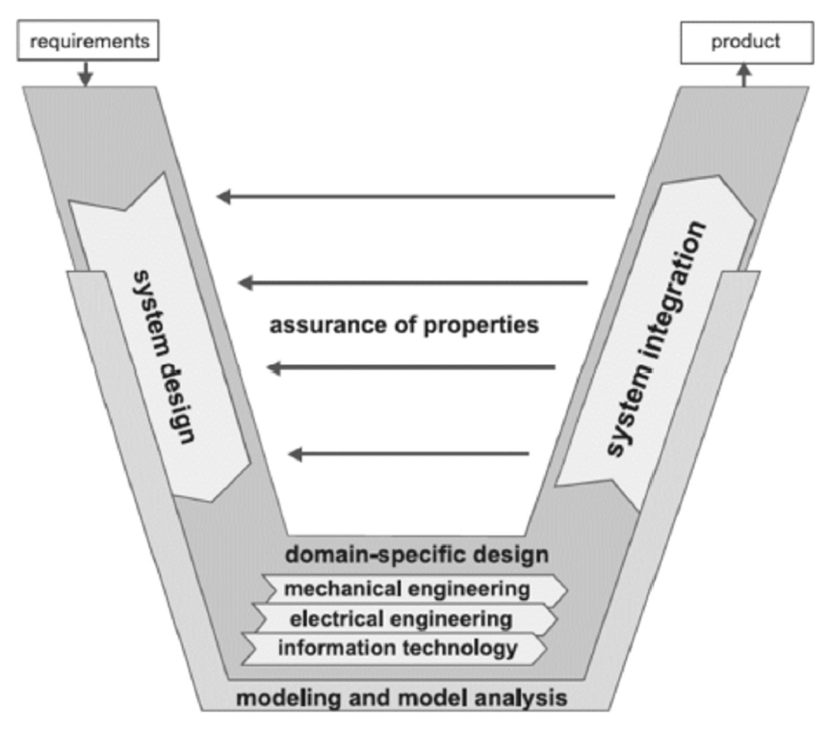
Project V-Model

Slide 10
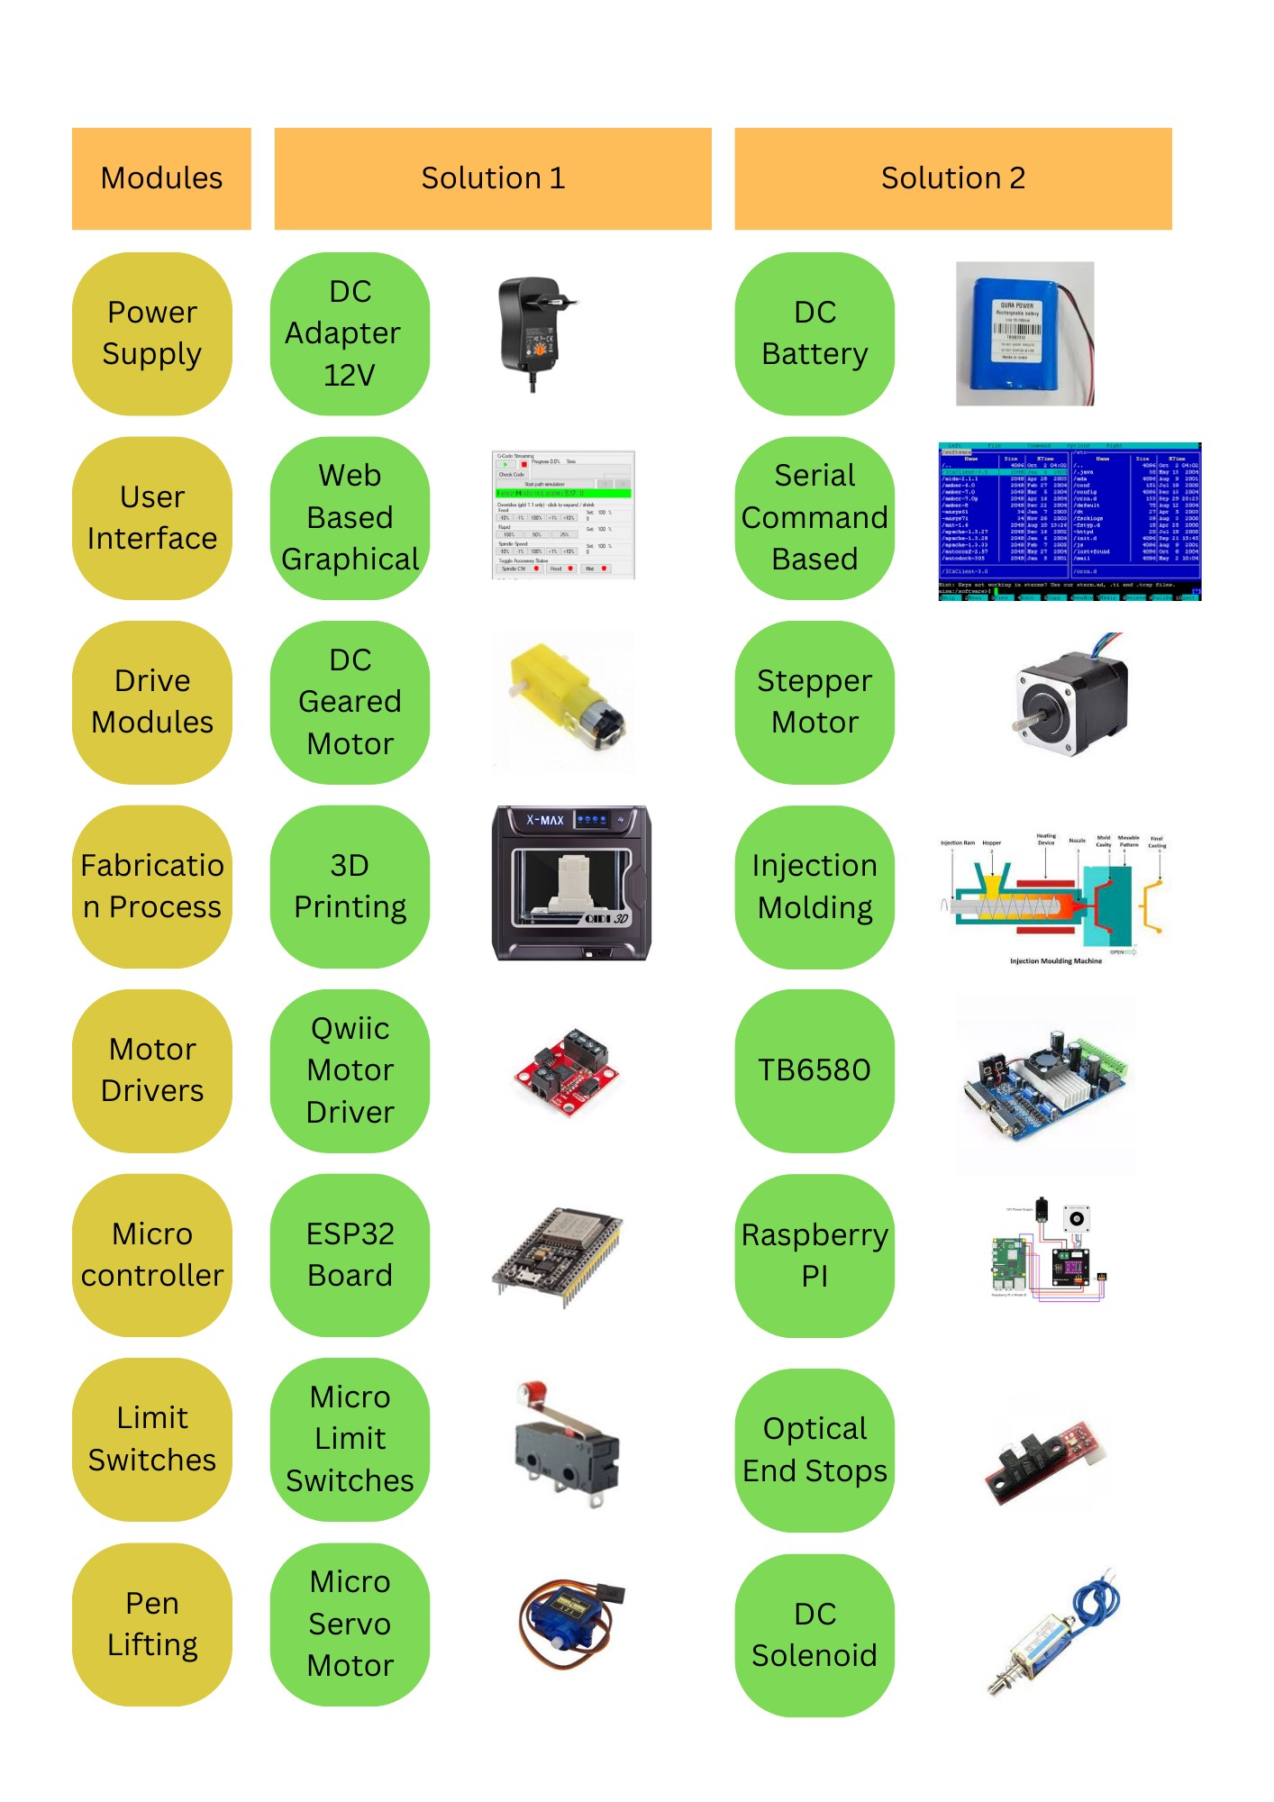
Morphological Chart

Slide 11
DESIGN STAGE

Slide 12
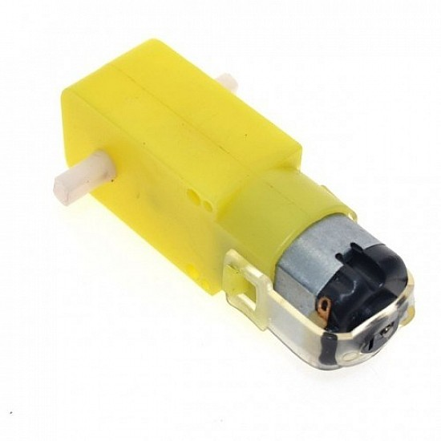
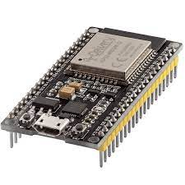
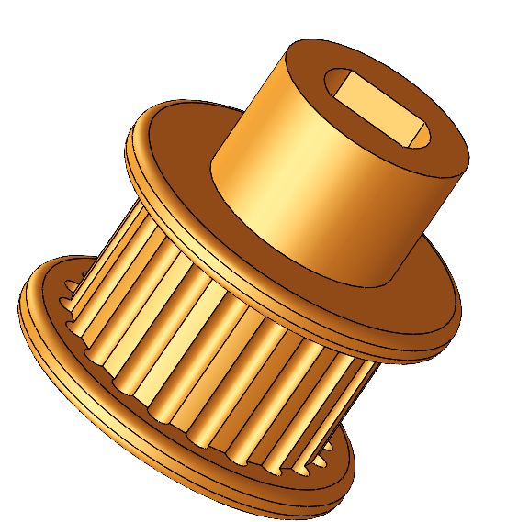
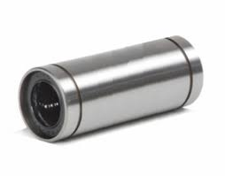
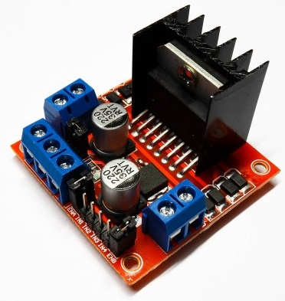
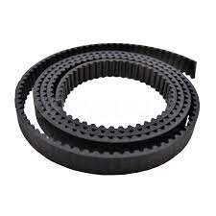
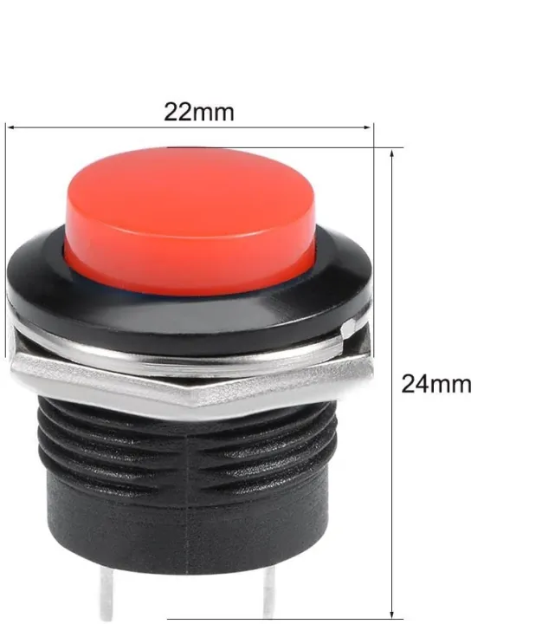
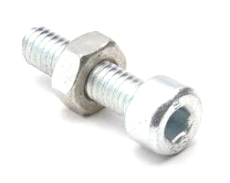
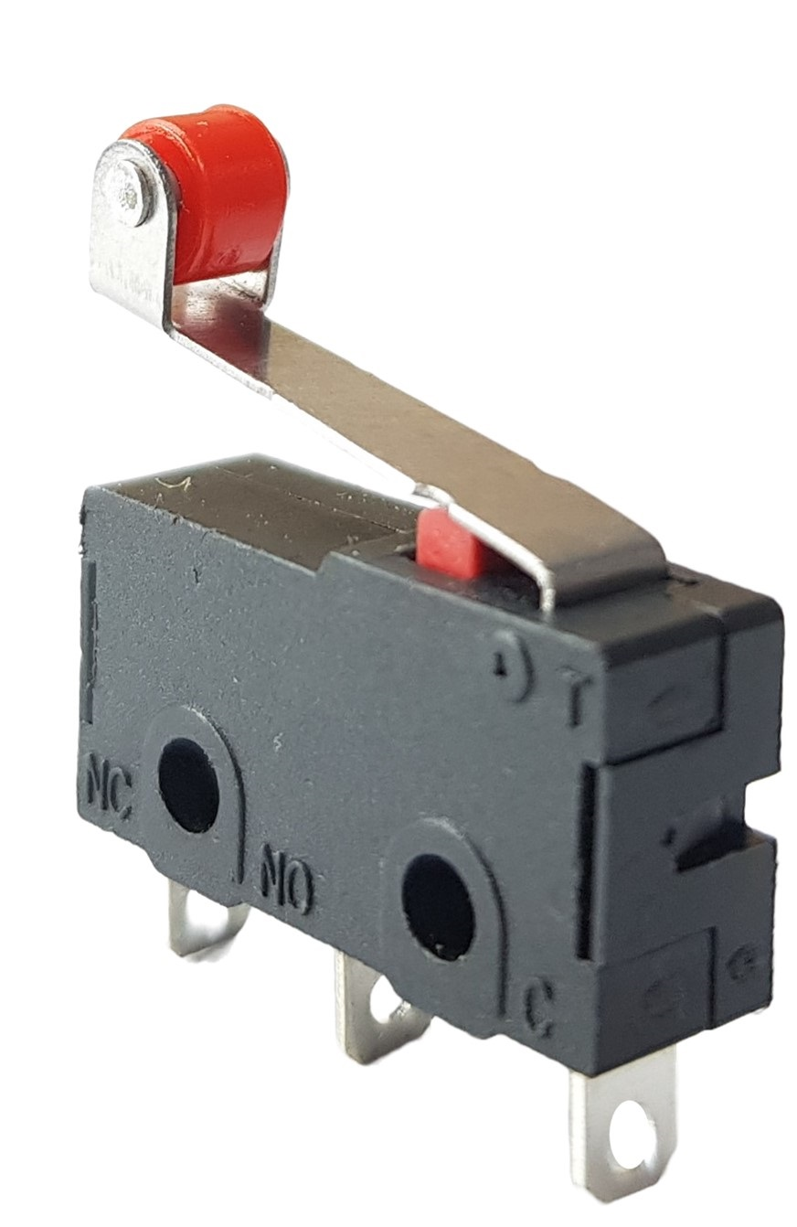
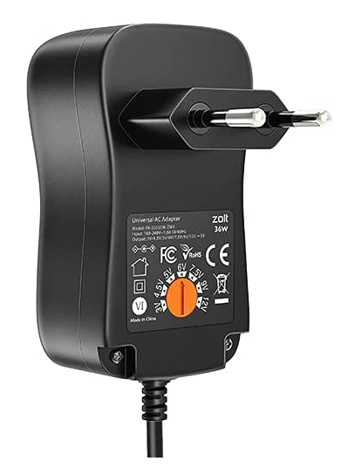
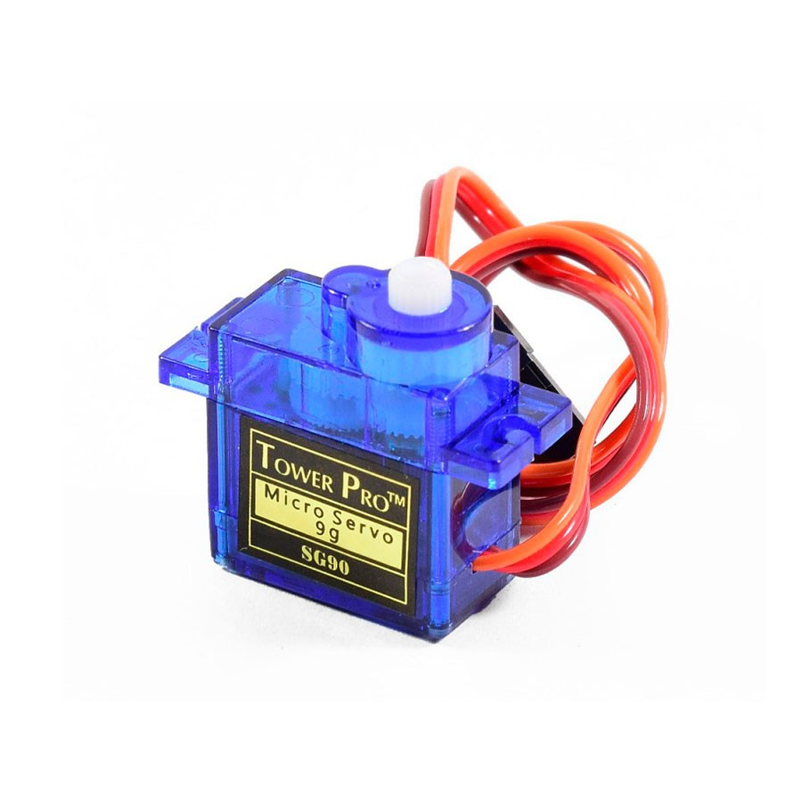
Components Selection
DC MOTOR
ESP32 BOARD
PULLEY
LINEAR BALL BEARINGS
L298N MOTOR
DRIVER
GT2 DRIVE BELT
PUSH BUTTON
SCREWS & FASTENERS
MICRO LIMIT SWITCH
ADAPTER
(DC POWER)
Microservo

Slide 13
Mechanical CAD Design
Pen Holder:
Securely holds pens of various sizes.
Allows quick changes, ensuring precise and consistent pressure.
End Effector:
Holds adjustable pens securely and precisely.
Lightweight, integrates seamlessly, and includes reliable lifting mechanism.
Foot Design:
Ensures stability and non-slip properties.
Compatible, adjustable, durable, and portable.
DC Motor Mount:
Secures motor for stable and precise movements.
Engineered for reliability and easy assembly.
Pulley Mount:
Positions pulleys for smooth movement.
Emphasizes stability and precision.
Sliding Pulley Mount:
Enables Y-direction movement for accuracy.
Specialized for smooth motion and power transmission.
Storage Compartments:
Organized housing for electrical components.
Space-efficient, accessible, and easy to maintain.
Base Plate:
Foundational chassis for stability and support.
Simplifies wiring, secures components, and allows easy control access.

Slide 14

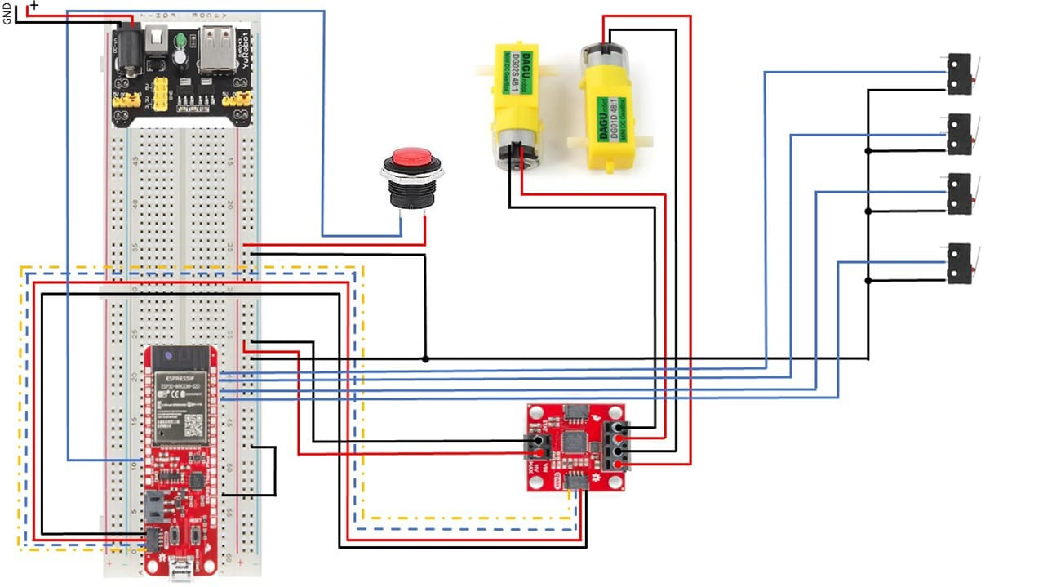
Electrical Design
Core Controller: ESP32 microcontroller orchestrates independent control of X and Y motors via quiic motor drivers
Vertical Motion: Micro servo with 5N force ensures accurate pen positioning, selectively activated by the microcontroller.
Safety Measures: Utilizing limit switches in the X-Y plane enhance safety, ensuring precise control and preventing damage.
Result: A comprehensive pen plotter design enabling precise control, accurate plotting, and improved reliability for intricate and high-quality drawings.

Slide 15
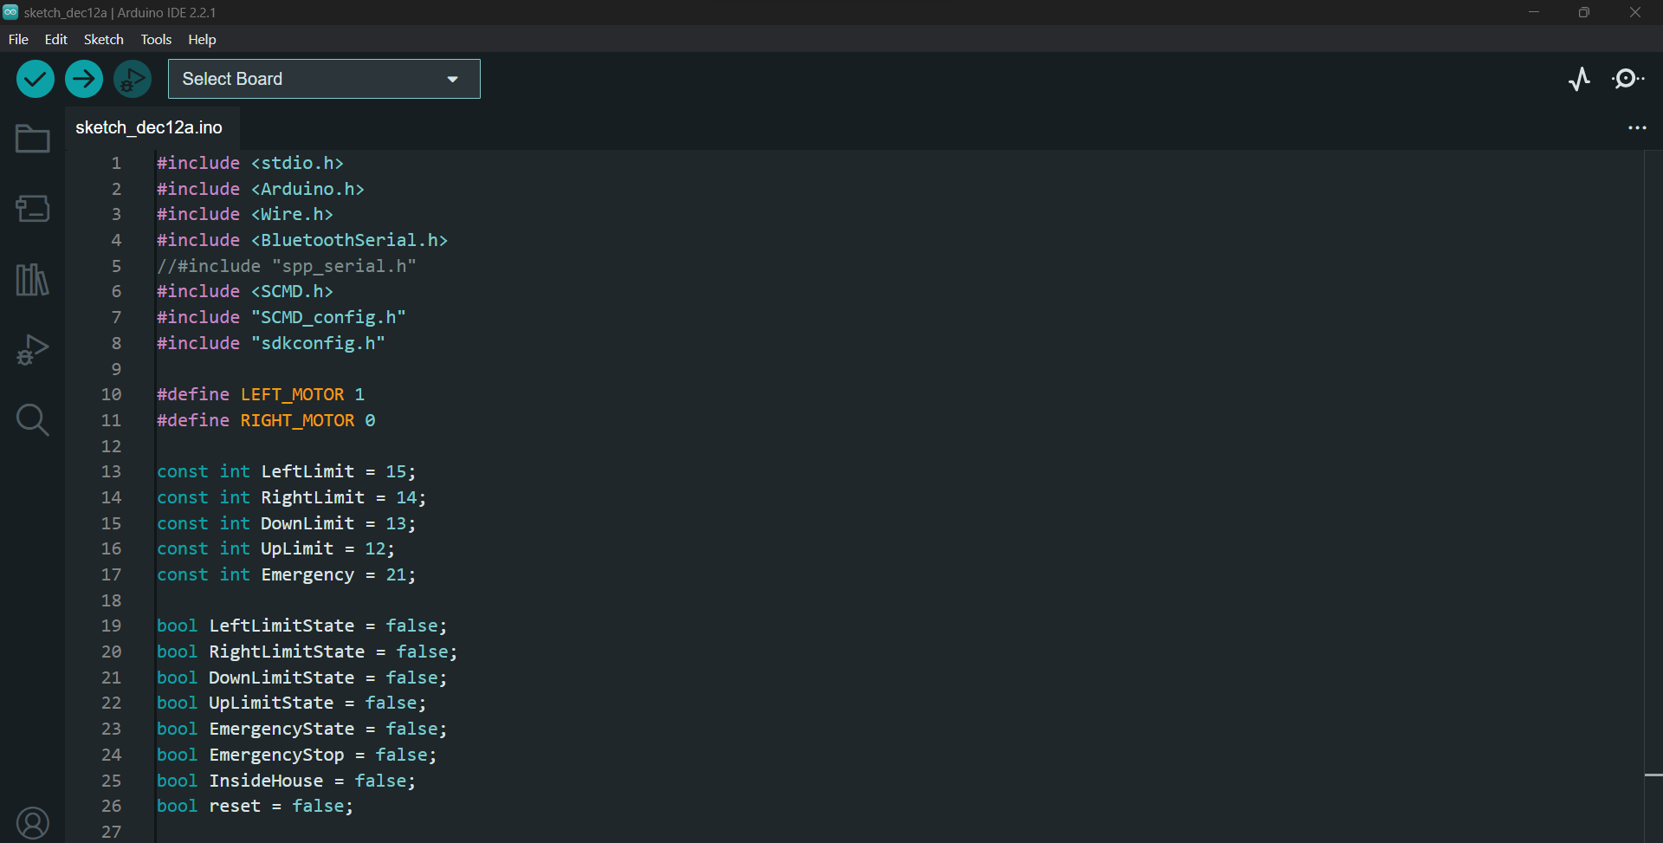
Programming
Communication with Hardware:
Implementation of a communication layer using G-code for hardware interaction.
Path Generation:
Algorithms for efficient pen movements considering factors like speed and precision.
Inverse Kinematics:
Algorithms for calculating joint angles, enabling accurate pen positioning.
Precision and Calibration:
Fine-tuning algorithms for accurate pen movements and calibration.
Real-time Coordination:
Synchronization of multiple stepper motors for intricate path following.
Optimization for Speed:
Code optimization crucial for smooth and efficient pen movements, especially in complex designs.

Slide 16
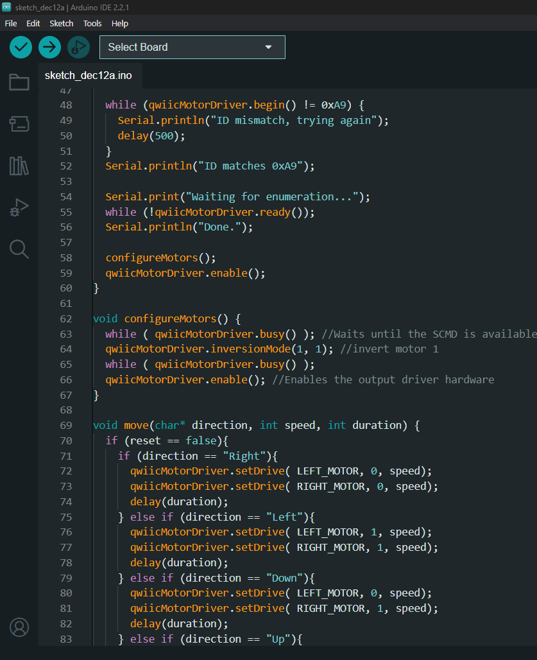
Concise Flowchart of Code
1. Start:
- Initialize serial communication and motor driver.
2. Main Loop:
- Read serial input.
- If '1', execute drawing sequence.
- If '2', return to home position.
3. Drawing Sequence:
- Check and handle emergency stop conditions.
- Move in specified directions.
- Stop motors.
4. Move To Home:
- Check limit switches and move to home if needed.
5. Read Switches:
- Read limit and emergency switches.
6. Check Limits:
- Move to home if any limit switch is triggered.
- Activate emergency stop if the emergency switch is triggered.
7. End:
- Display messages based on the current state..

Slide 17
DEVELOPMENT AND FABRICATION STAGE

Slide 18
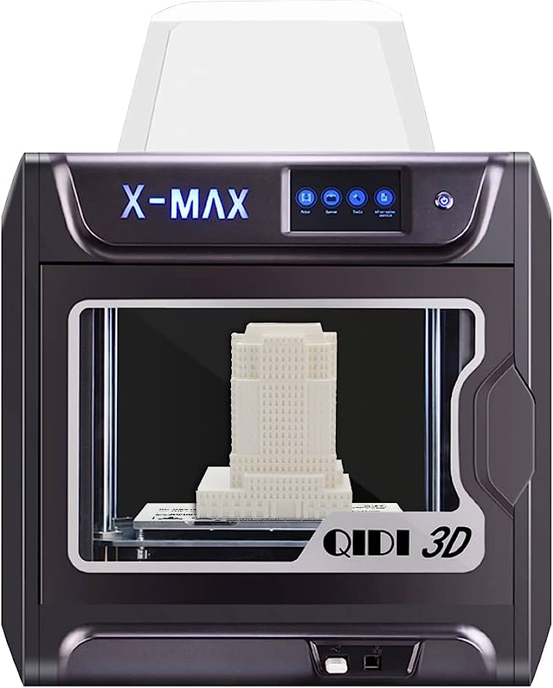
Selection of materials
PLA filament reigns supreme in FDM 3D printing as the quintessential entry-level choice. Its unrivaled attributes, including exceptional printability and minimal warping, make it the top pick for creators.
The ease of use, affordability, and seamless compatibility with standard 3D printers elevate PLA to an unparalleled status.
Moreover, its eco-friendly composition aligns with sustainable practices.
Exclusively printed on the state-of-the-art QIDI TECH X-MAX 3D Printer in the prestigious AKT lab, Haus D, every 3D component emerges as a masterpiece—a testament to the seamless fusion of innovation and precision.

Slide 19
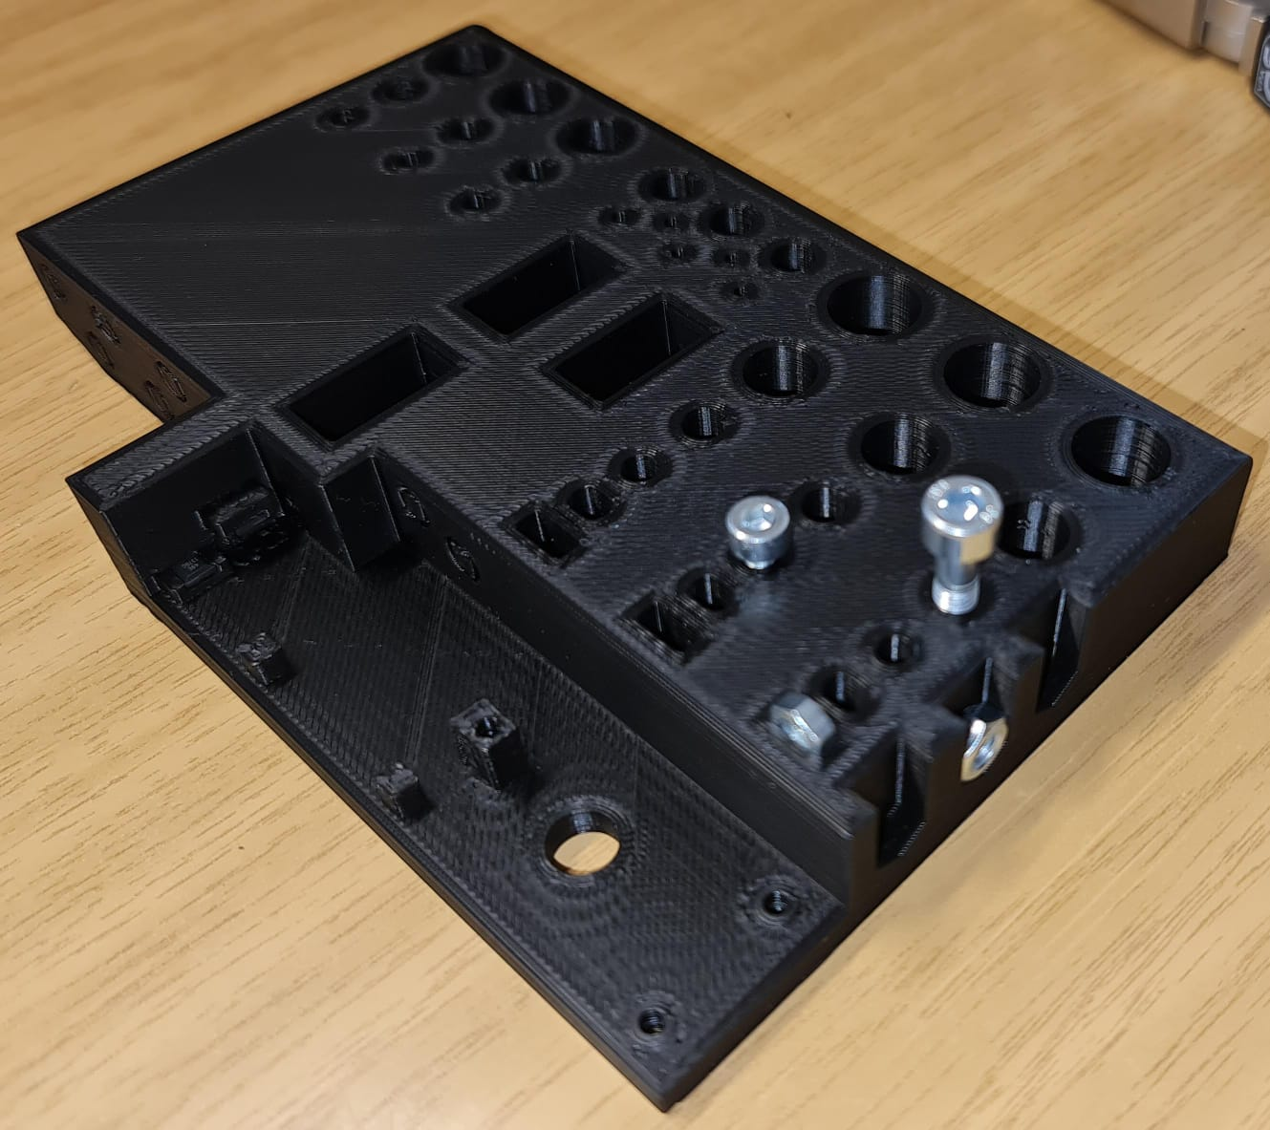
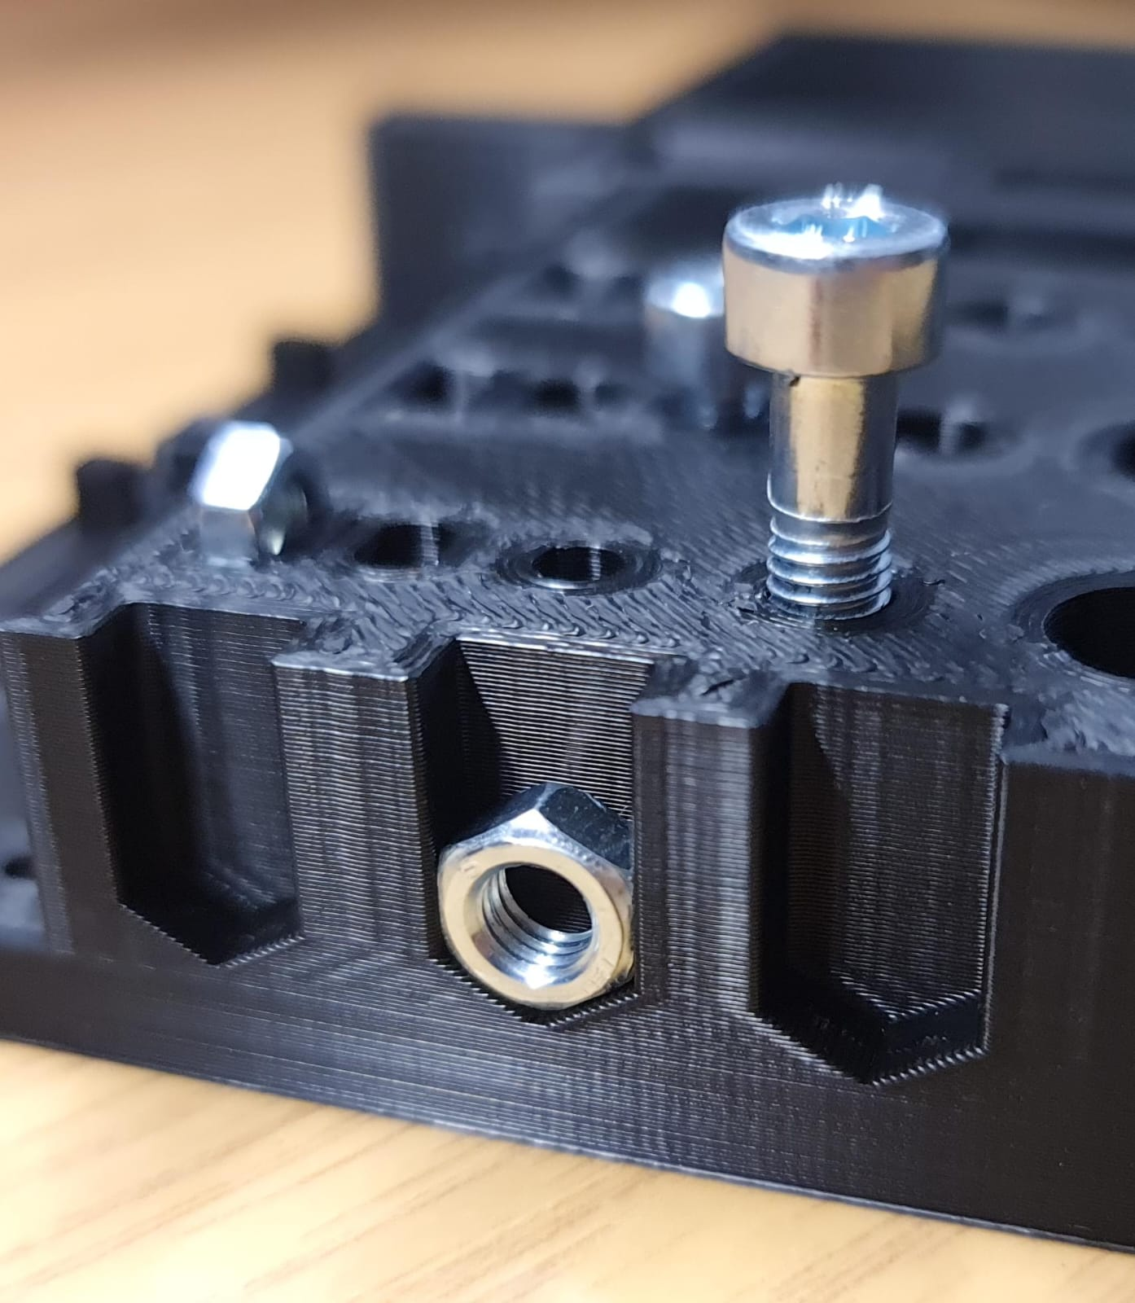
Application of test piece
After the Mechanical design completion, the test piece was printed at first to emphasize the need for accuracy and to ensure proper functionality and alignment.
Relevant information received from test piece was used to rectify and improve the design.
This helps in identifying any issues or performance gaps early in the design process and reduce the need for rework later on.

Slide 20
Challenges faced during Development Stage:
Efficient wire routing is essential for visual appeal and professionalism in electronics.
Exposed wires create a cluttered look and are prone to accidents, leading to potential damage.
To address this, we designed an enclosure using plastic cable conduits.
The conduits neatly house and guide wiring, ensuring a sleek and secure solution for electronic components.

Slide 21
TESTING AND ITERATION

Slide 22
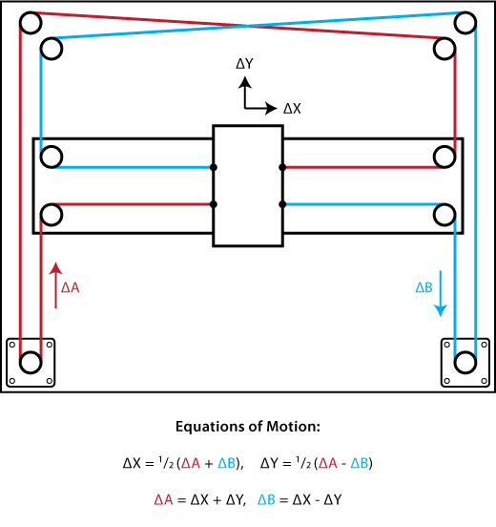
Testing Procedure
Testing and Iteration
- Assess functionality, performance, and reliability.
- Focus on motion control and pen actuation.
- Goal: Identify issues, refine for better performance.
Challenges
1. Color Range: Limited to monochrome or narrow spectrum.
2. Speed: Slower for large-scale tasks.
3. Accuracy: Stepper motors offer precision.
4. Compatibility: Optimal on flat materials.
Cable Management
- Planned routes for smooth plotter movement.
- Objective: Reduce entanglement, ensure reliability.
Significance
- Address interference and signal disruptions.
- Considerations: cable length, flexibility, secure attachment.
- Optimize performance, minimize malfunctions.

Slide 23
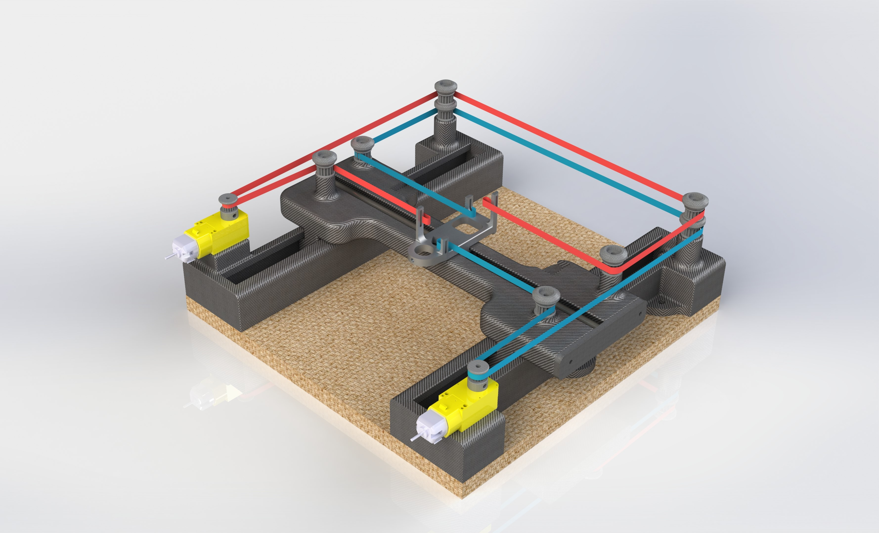
Performance Testing & Calibration
Calibration is like a precise dance, adjusting important settings such as motor size and pen movement.
It's a step-by-step process, with careful testing each time to make sure everything works perfectly.
The goal is perfection, and we keep making small changes to improve with each try.
Think of it as an art – always trying to be the best and committed to excellence.
Data quietly guides us, helping all the adjustments come together smoothly for the best performance.

Slide 24
CONCLUSIONS

Slide 25
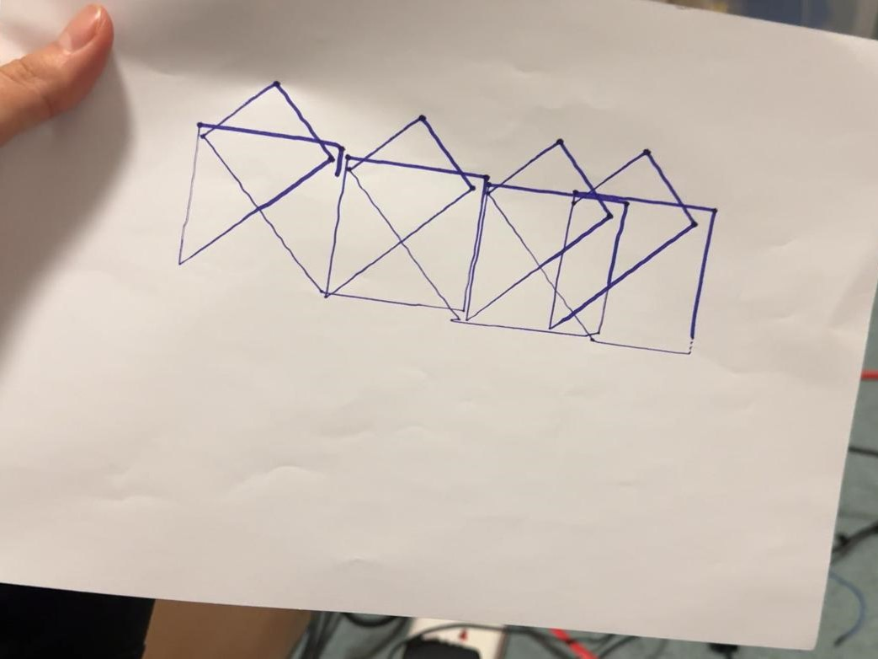
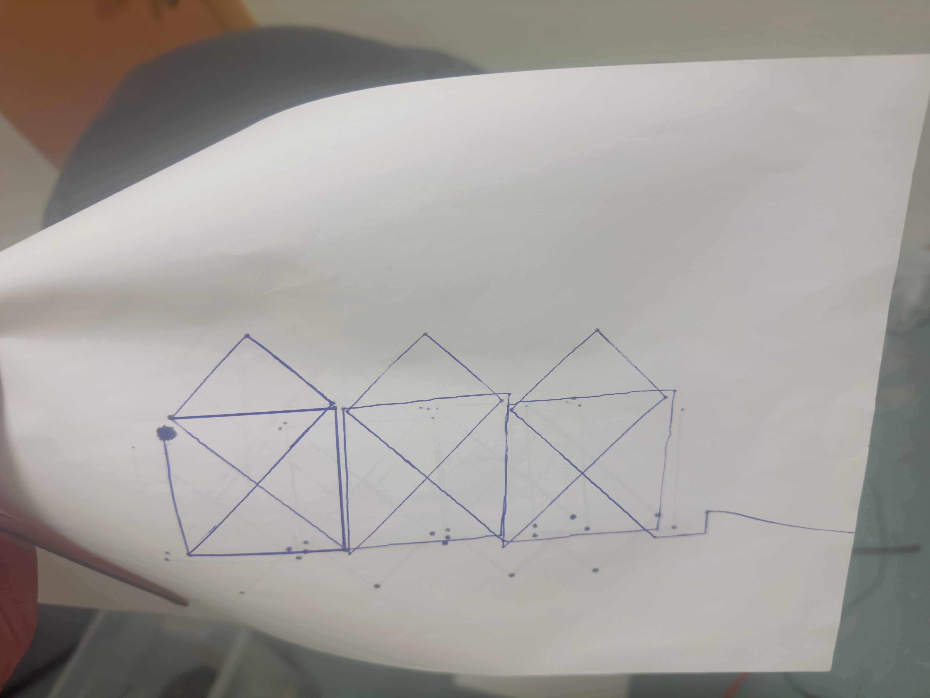
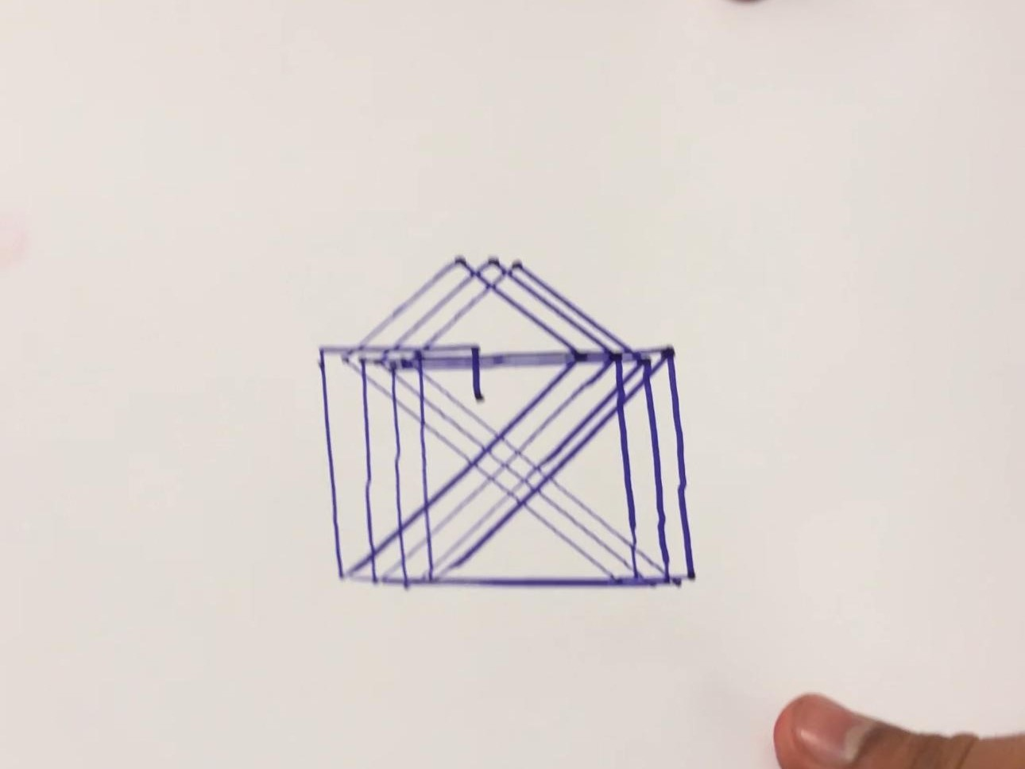
Task: Plot Nikolaus Haus
Finally, after completing design stage, fabrication of components, hours of coding and innumerable test runs, we were able to plot the Nikolaus Haus.
Given the starting point for Nikolaus Haus, the Pen plotter could plot a total of 44 combinations through Point 1 or Point 2 (total 88 combinations) without repeating the drawing patterns.

Slide 26
Pen Plotter Working

Slide 27
Future Scope
1. Colorful Drawings:
Enable multi-colored drawings with a pen plotter capable of holding different colored pens or markers.
2. Precision Enhancement:
Upgrade accuracy using servo motors with encoders and PID control for smooth motion.
3. Diverse Designs with GRBL:
Integrate GRBL software for user-defined drawings, expanding creative possibilities.
4. Advanced Motors for Quality:
Implement higher-quality DC geared motors for finer positioning and improved drawing quality.
5. Compact and Vibration-Free:
Focus on future designs for a compact, lightweight plotter with reduced vibrations, ensuring efficiency and reliability.

Slide 28
THANK YOU !

